Slide 1
MA3077 (DLI) Operational Research Lecture 19 – Birth and death processes
Dr Marco Fasondini

Slide 2
Recapitulation and lecture outline
Recap: so far, we have learnt:
how to describe abstract queueing systems models,
the relationships between the exponential distribution and Poisson processes,
how to analyse the M/M/1 system.
In this lecture: The birth-and-death process to generalise the M/M/1 model (following more-or-less-closely Ch. 17.5 and Ch. 17.6 of the book by Hillier and Lieberman).

Slide 3
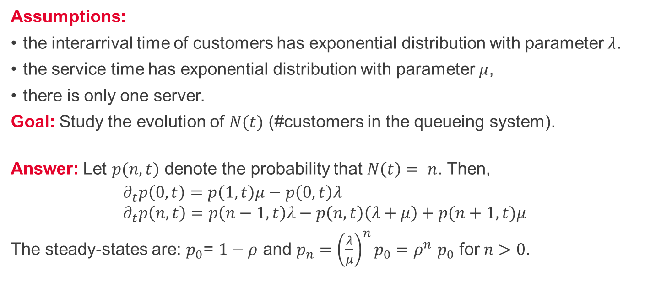
The M/M/1 model - summary
Assumptions:
the interarrival time of customers has exponential distribution with parameter $λ$.
the service time has exponential distribution with parameter $μ$,
there is only one server.
Goal: Study the evolution of $N(t)$ (#customers in the queueing system).
Answer: Let $p(n,t)$ denote the probability that $N\left(t\right)= n$. Then,
$$∂_{t}p\left(0,t\right)=p\left(1,t\right)μ−p\left(0,t\right)λ \\ ∂_{t}p\left(n,t\right)=p\left(n−1,t\right)λ−p\left(n,t\right)\left(λ+μ\right)+p(n+1,t)μ$$
The steady-states are: $p_{0}\text{= }1−ρ$ and $p_{n}={\left(\frac{λ}{μ}\right)}^{n}p_{0}{=ρ}^{n}p_{0}$ for $n>0$.

Slide 4
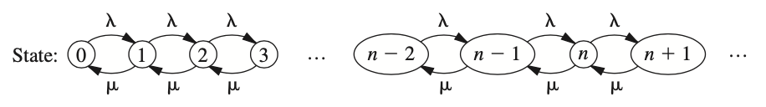
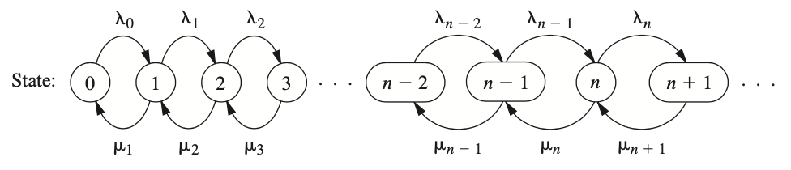
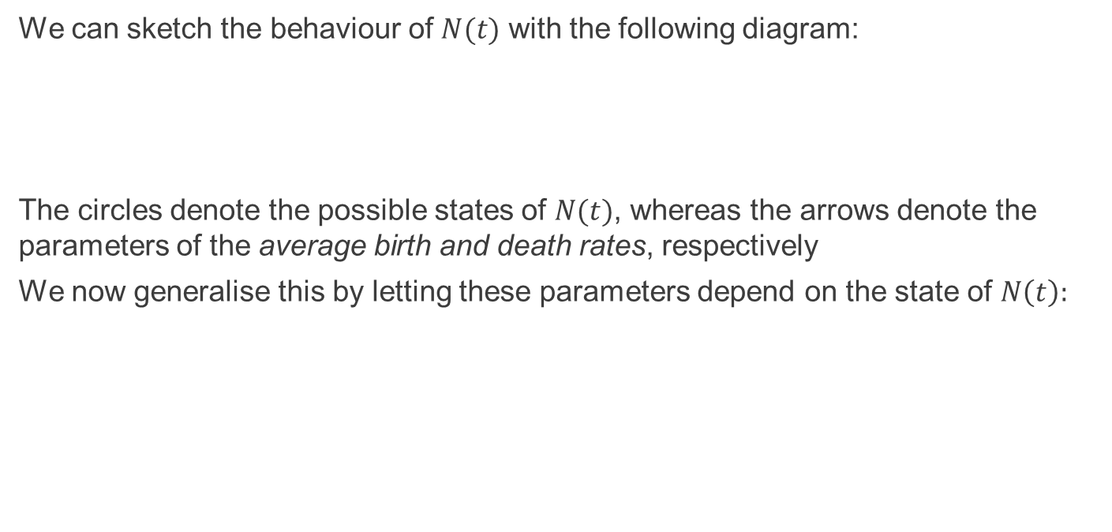
The M/M/1 model as a birth-and-death process
We can sketch the behaviour of $N(t)$ with the following diagram:
The circles denote the possible states of $N(t)$, whereas the arrows denote the parameters of the average birth and death rates, respectively
We now generalise this by letting these parameters depend on the state of $N\left(t\right):$

Slide 5
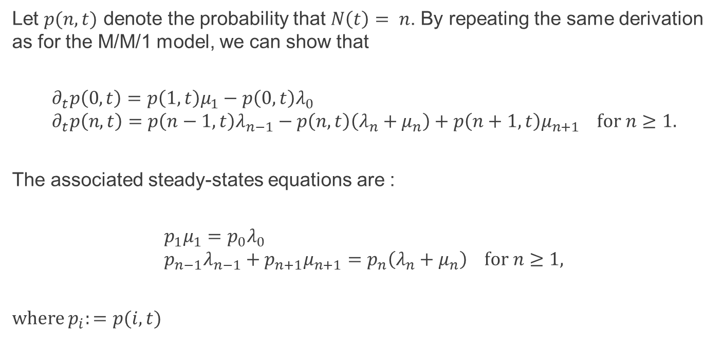
Birth-and-death processes 1/2
Let $p(n,t)$ denote the probability that $N\left(t\right)= n$. By repeating the same derivation as for the M/M/1 model, we can show that
$$∂_{t}p\left(0,t\right)=p\left(1,t\right)μ_{1}−p\left(0,t\right)λ_{0} \\ ∂_{t}p\left(n,t\right)=p\left(n−1,t\right)λ_{n−1}−p\left(n,t\right)\left(λ_{n}+μ_{n}\right)+p\left(n+1,t\right)μ_{n+1} for n≥1.$$
The associated steady-states equations are :
$$p_{1}μ_{1}=p_{0}λ_{0} \\ p_{n−1}λ_{n−1}+p_{n+1}μ_{n+1}=p_{n}\left(λ_{n}+μ_{n}\right) for n≥1,$$
where $p_{i}:=p(i,t)$

Slide 6
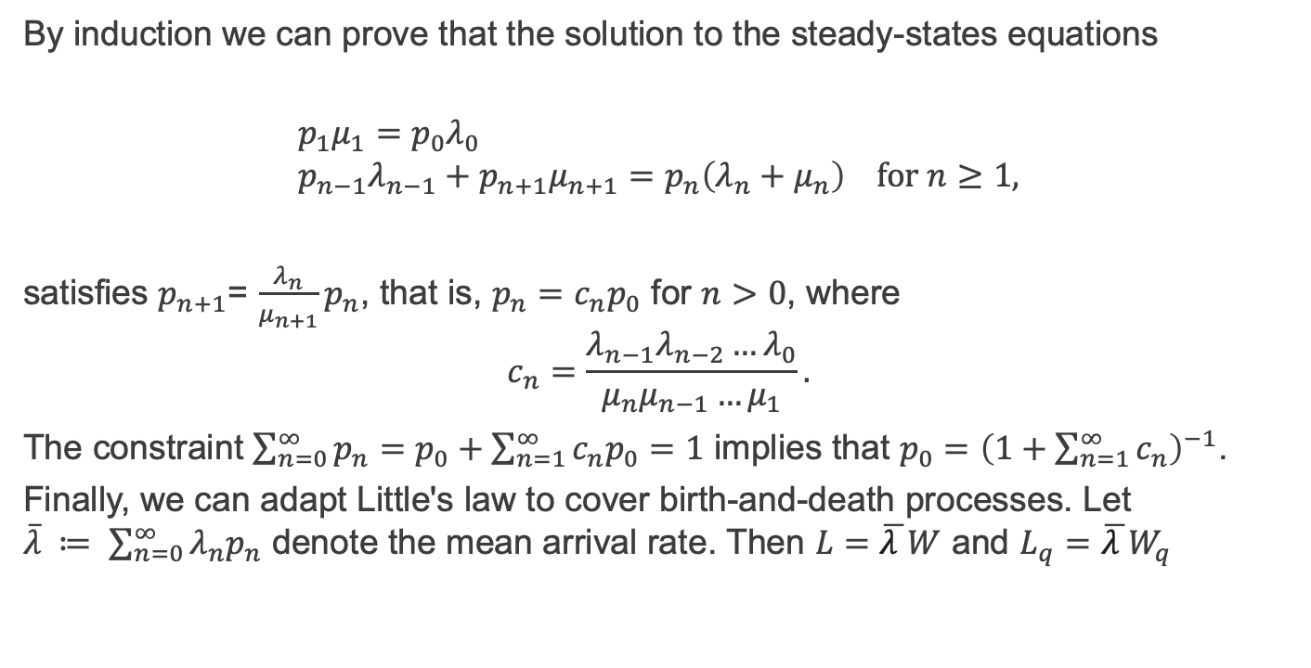
Birth-and-death processes 2/2
By induction we can prove that the solution to the steady-states equations
$$p_{1}μ_{1}=p_{0}λ_{0} \\ p_{n−1}λ_{n−1}+p_{n+1}μ_{n+1}=p_{n}\left(λ_{n}+μ_{n}\right) for n≥1,$$
satisfies $p_{n+1}$= $\frac{λ_{n}}{μ_{n+1}}p_{n}$, that is, $p_{n}=c_{n}p_{0}$ for $n>0$, where $$c_{n}=\frac{{λ_{n−1}λ_{n−2}…λ}_{0}}{μ_{n}μ_{n−1}…μ_{1}}.$$
The constraint $\sum_{n=0}^{∞}{p_{n}}=p_{0}+\sum_{n=1}^{∞}{c_{n}p_{0}}=1$ implies that $p_{0}={\left(1+\sum_{n=1}^{∞}{c_{n}}\right)}^{−1}$.
Finally, we can adapt Little's law to cover birth-and-death processes. Let $\overline{λ} ≔ \sum_{n=0}^{∞}{λ_{n}p_{n}}$ denote the mean arrival rate. Then $L=\overline{λ }W$ and $L_{q}=\overline{λ }W_{q}$

Slide 7
Example
The owner of (and unique worker in) the small local coffee shop at the corner has decided to hire a trainee. When there's only one customer, the trainee takes the order and prepares the required beverages. However, if there's more than one customer, the owner steps in to provide service to an additional customer. On average, the trainee needs 6 minutes to serve a customer, whereas the owner only needs 3 minutes.
Assuming these have exponential distribution and that customers arrive at the coffee shop following a Poisson distribution with mean rate of 20 customers per hour, compute: the steady-states of the number of customers in the coffee shop, the probability that the queue is empty, the expected number of customers and of customers in the queue, the associated waiting times, and the mean service time.

Slide 8
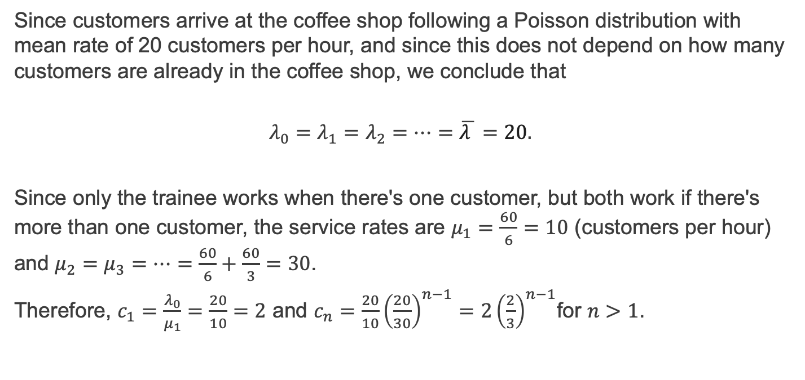
Example – solution 1/3
Since customers arrive at the coffee shop following a Poisson distribution with mean rate of 20 customers per hour, and since this does not depend on how many customers are already in the coffee shop, we conclude that
$$λ_{0}=λ_{1}=λ_{2}=…=\overline{λ }=20.$$
Since only the trainee works when there's one customer, but both work if there's more than one customer, the service rates are $μ_{1}=\frac{60}{6}=10$ (customers per hour) and $μ_{2}=μ_{3}=…=\frac{60}{6}+\frac{60}{3}=30$.
Therefore, $c_{1}=\frac{λ_{0}}{μ_{1}}=\frac{20}{10}=2$ and $c_{n}=\frac{20}{10}{\left(\frac{20}{30}\right)}^{n−1}=2{\left(\frac{2}{3}\right)}^{n−1}$for $n>1$.

Slide 9
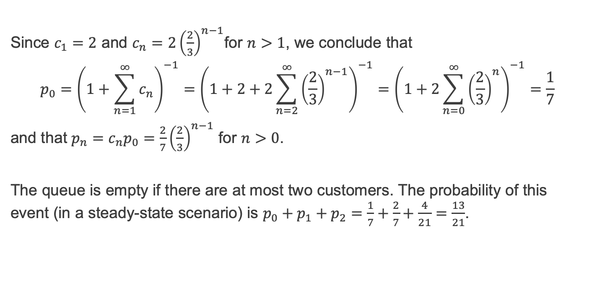
Example – solution 2/3
Since $c_{1}=2$ and $c_{n}=2{\left(\frac{2}{3}\right)}^{n−1}$for $n>1$, we conclude that
$$p_{0}={\left(1+\sum_{n=1}^{∞}{c_{n}}\right)}^{−1}={\left(1+2+2\sum_{n=2}^{∞}{{\left(\frac{2}{3}\right)}^{n−1}}\right)}^{−1}={\left(1+2\sum_{n=0}^{∞}{{\left(\frac{2}{3}\right)}^{n}}\right)}^{−1}=\frac{1}{7}$$
and that $p_{n}=c_{n}p_{0}=\frac{2}{7}{\left(\frac{2}{3}\right)}^{n−1}$ for $n>0$.
The queue is empty if there are at most two customers. The probability of this event (in a steady-state scenario) is $p_{0}+p_{1}+p_{2}=\frac{1}{7}+\frac{2}{7}+\frac{4}{21}=\frac{13}{21}$.

Slide 10
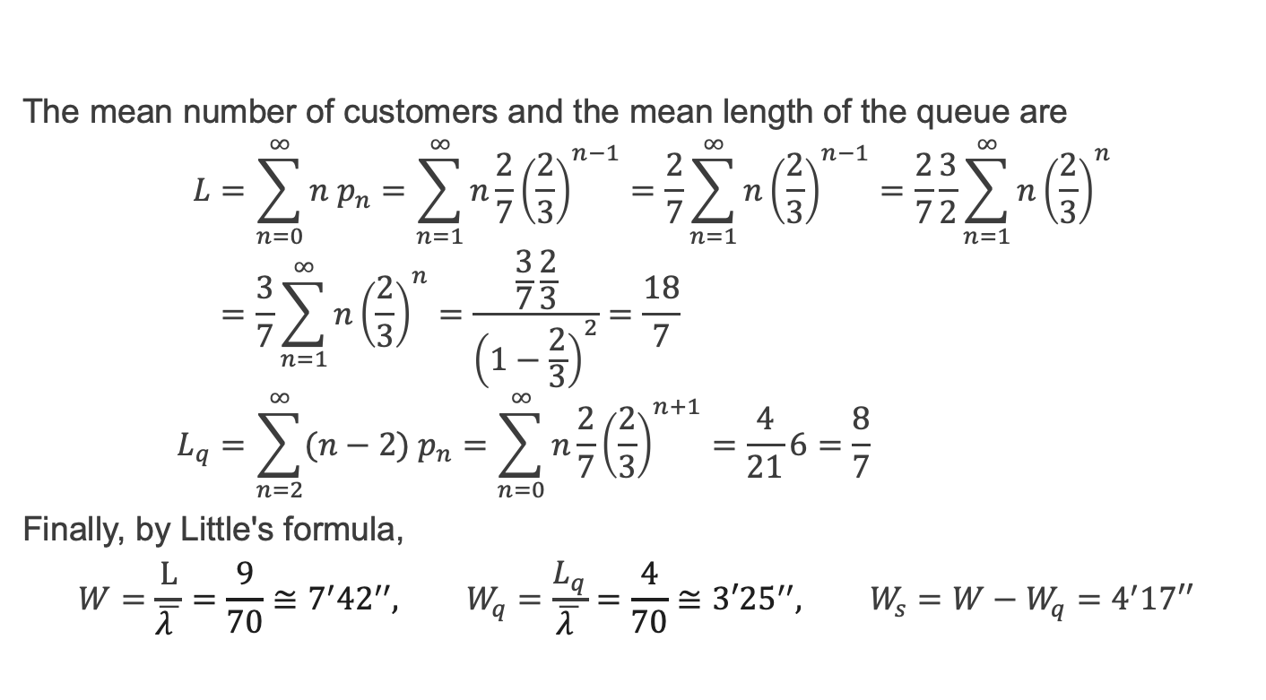
Example – solution 3/3
The mean number of customers and the mean length of the queue are
$$L=\sum_{n=0}^{∞}{n{ p}_{n}}=\sum_{n=1}^{∞}{n\frac{2}{7}{\left(\frac{2}{3}\right)}^{n−1}}=\frac{2}{7}\sum_{n=1}^{∞}{n{\left(\frac{2}{3}\right)}^{n−1}}=\frac{2}{7}\frac{3}{2}\sum_{n=1}^{∞}{n{\left(\frac{2}{3}\right)}^{n}} \\ =\frac{3}{7}\sum_{n=1}^{∞}{n{\left(\frac{2}{3}\right)}^{n}}=\frac{\frac{3}{7}\frac{2}{3}}{{\left(1−\frac{2}{3}\right)}^{2}}=\frac{18}{7} \\ L_{q}=\sum_{n=2}^{∞}{(n−2){ p}_{n}}=\sum_{n=0}^{∞}{n\frac{2}{7}{\left(\frac{2}{3}\right)}^{n+1}}=\frac{4}{21}6=\frac{8}{7}$$
Finally, by Little's formula,
$$W=\frac{L}{\overline{λ }}=\frac{9}{70}≅7^{′}{42}^{′′}, W_{q}=\frac{L_{q}}{\overline{λ }}=\frac{4}{70}≅3′{25}^{′′}, W_{s}=W−W_{q}=4^{′}17′′$$

Slide 11
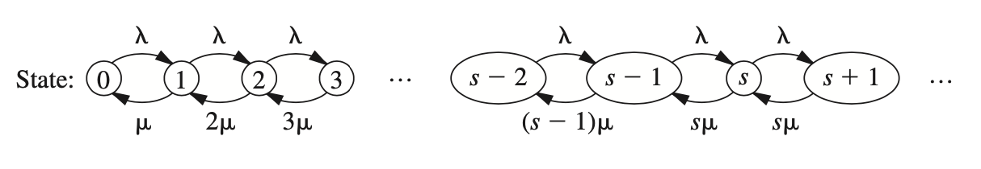
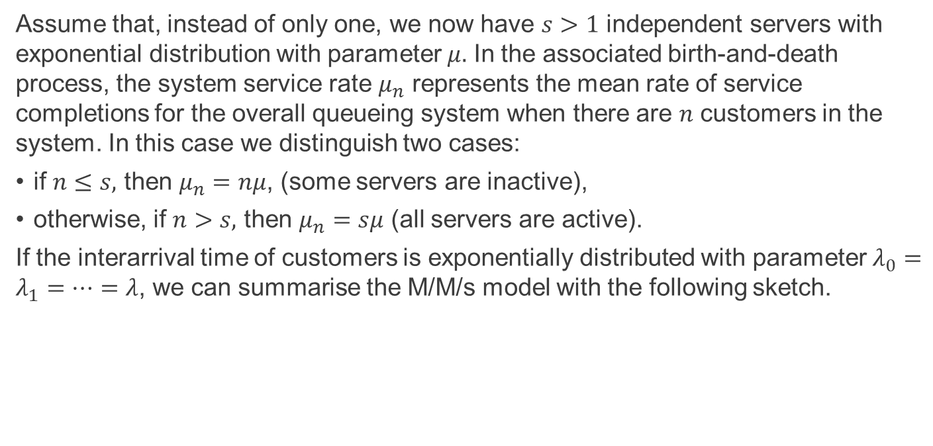
The M/M/s model 1/2
Assume that, instead of only one, we now have $s>1$ independent servers with exponential distribution with parameter $μ.$ In the associated birth-and-death process, the system service rate $μ_{n}$ represents the mean rate of service completions for the overall queueing system when there are $n$ customers in the system. In this case we distinguish two cases:
if $n≤s,$ then $μ_{n}=nμ$, (some servers are inactive),
otherwise, if $n>s,$ then $μ_{n}=sμ$ (all servers are active).
If the interarrival time of customers is exponentially distributed with parameter $λ_{0}=λ_{1}=…=λ$, we can summarise the M/M/s model with the following sketch.

Slide 12
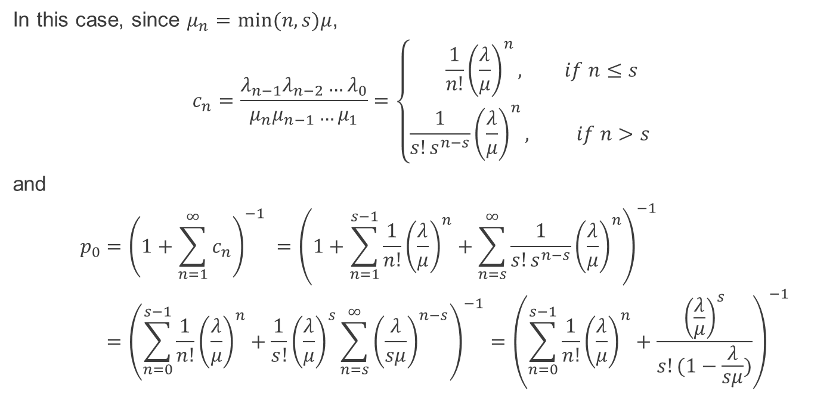
The M/M/s model 2/2
In this case, since $μ_{n}=min⁡(n,s)μ$,
$$c_{n}=\frac{{λ_{n−1}λ_{n−2}…λ}_{0}}{μ_{n}μ_{n−1}…μ_{1}}=\left\{\begin{aligned} \frac{1}{n!}{\left(\frac{λ}{μ}\right)}^{n}, if n≤s \\ &\frac{1}{s!s^{n−s}}{\left(\frac{λ}{μ}\right)}^{n}, if n>s\end{aligned}\right.$$
and
$$p_{0}={\left(1+\sum_{n=1}^{∞}{c_{n}}\right)}^{−1} ={\left(1+\sum_{n=1}^{s−1}{\frac{1}{n!}{\left(\frac{λ}{μ}\right)}^{n}}+\sum_{n=s}^{∞}{\frac{1}{s!s^{n−s}}{\left(\frac{λ}{μ}\right)}^{n}}\right)}^{−1} \\ ={\left(\sum_{n=0}^{s−1}{\frac{1}{n!}{\left(\frac{λ}{μ}\right)}^{n}}+\frac{1}{s!}{\left(\frac{λ}{μ}\right)}^{s}\sum_{n=s}^{∞}{{\left(\frac{λ}{sμ}\right)}^{n−s}}\right)}^{−1}={\left(\sum_{n=0}^{s−1}{\frac{1}{n!}{\left(\frac{λ}{μ}\right)}^{n}}+\frac{{\left(\frac{λ}{μ}\right)}^{s}}{s!(1−\frac{λ}{sμ})}\right)}^{−1}$$

Slide 13
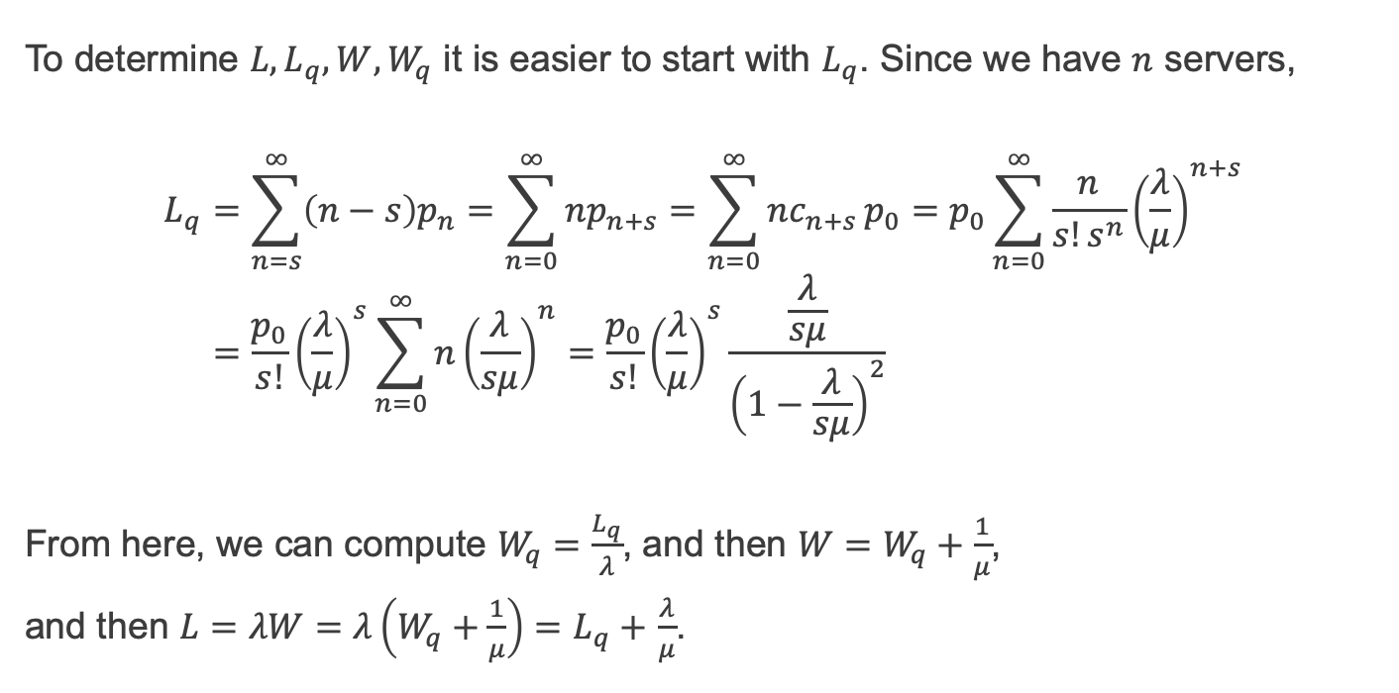
The M/M/s model – averaged quantities
To determine $L, L_{q},W, W_{q}$ it is easier to start with $L_{q}$. Since we have $n$ servers,
$$L_{q}=\sum_{n=s}^{∞}{\left(n−s\right)p_{n}}=\sum_{n=0}^{∞}{np_{n+s}}=\sum_{n=0}^{∞}{nc_{n+s}}p_{0}=p_{0}\sum_{n=0}^{∞}{\frac{n}{s!s^{n}}{\left(\frac{λ}{μ}\right)}^{n+s}} \\ =\frac{p_{0}}{s!}{\left(\frac{λ}{μ}\right)}^{s}\sum_{n=0}^{∞}{n{\left(\frac{λ}{sμ}\right)}^{n}}=\frac{p_{0}}{s!}{\left(\frac{λ}{μ}\right)}^{s}\frac{\frac{λ}{sμ}}{{\left(1−\frac{λ}{sμ}\right)}^{2}}$$
From here, we can compute $W_{q}=\frac{L_{q}}{λ}$, and then $W=W_{q}+\frac{1}{μ}$,
and then $L=λW=λ\left(W_{q}+\frac{1}{μ}\right)=L_{q}+$ $\frac{λ}{μ}$.

Slide 14
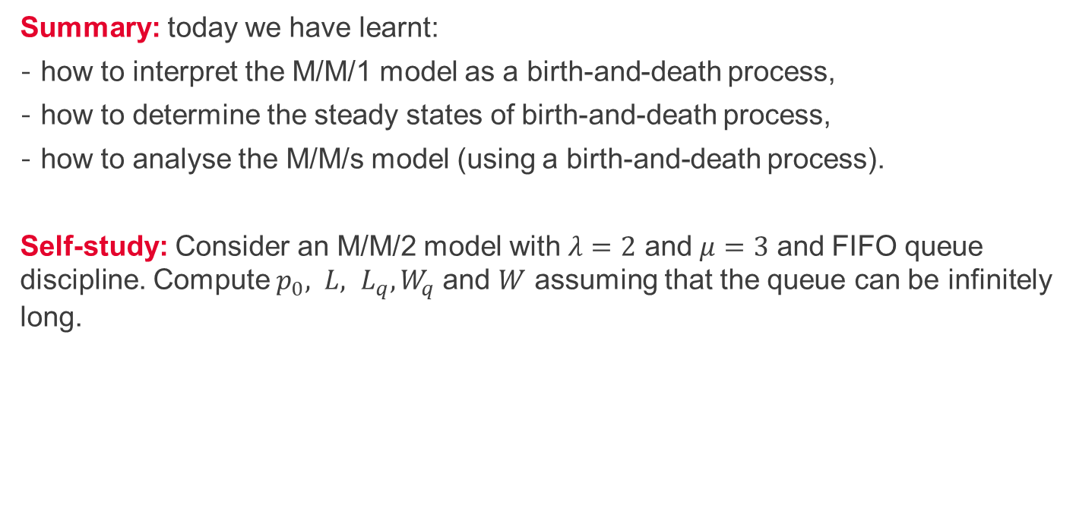
Summary and self-study
Summary: today we have learnt:
how to interpret the M/M/1 model as a birth-and-death process,
how to determine the steady states of birth-and-death process,
how to analyse the M/M/s model (using a birth-and-death process).
Self-study: Consider an M/M/2 model with $λ=2$ and $μ=3$ and FIFO queue discipline. Compute $p_{0}, L, L_{q}, W_{q}$and $W$ assuming that the queue can be infinitely long.

